Slide 1


F
A
S
H
C
A
M
……a Reverse Image Search Engine

Slide 2
About FASHCAM
FashCam is one of the powerful reverse image search engines.
With this:
Customers can easily upload a picture of the desired item or take a live picture, select the piece of object with the help of crop feature, so this engine can find exactly the same or similar fashion goods.

Slide 3
Benefits for e-commerce
FashCam visual search improves product discovery and purchase experience leading to higher conversions and revenue for eCommerce brands.
Customers can search for products using images, resulting in a quicker and more accurate path to purchase.
The unique and easy search experience offered by FashCam drives product sales and boost revenue.

Slide 4

Demo : 1. Uploading an image of product

Slide 5
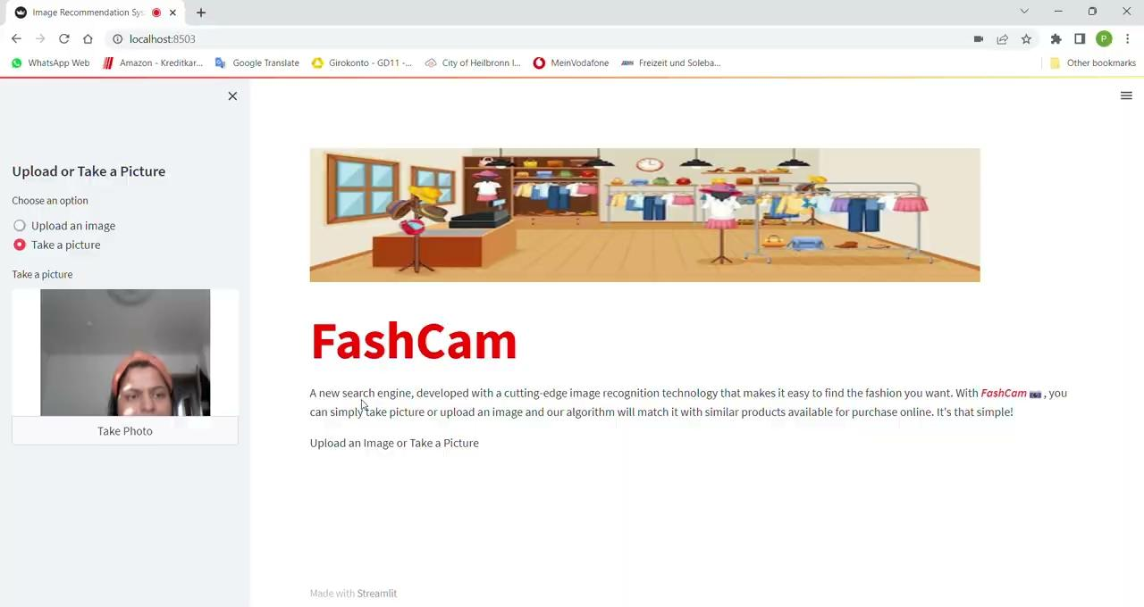
Demo : 2. Take a picture of product

Slide 6
Limitation & Improvement
It takes up to a couple of seconds to load the results.
Limited collection of recommended products.
It may misclassify noisy, unclear or blurry pictures.

